Slide 1
Asynchronous Data Transfer
Lecture 43-45

Slide 2
Data Transfer
Data transfer is the process of moving data from one location to another. There are different types of data transfer, including synchronous and asynchronous data transfer.
Synchronous Data Transfer: Synchronous data transfer occurs in real-time, where the sender and receiver synchronize their clocks to ensure data is transmitted at a consistent rate. This type of transfer is often used in applications where timing is critical, such as live streaming or real-time communication.
Asynchronous Data Transfer: Asynchronous data transfer doesn't require synchronized clocks between the sender and receiver. Instead, data is sent in packets with start and stop bits to indicate the beginning and end of each data unit. This method is common in computer networks and serial communication.

Slide 3
Asynchronous Data Transfer
In most cases, the internal timing in each unit is independent from the other in that each uses its own private clock for internal registers. In that case, the two units are said to be asynchronous to each other. This approach is widely used in most computer systems.
Asynchronous data transfer between two independent units requires that control signals be transmitted between the communicating units to indicate the time at which data is being transmitted.
One way of achieving this is by means of a strobe pulse supplied by one of the units to indicate to the other unit when the transfer has to occur.
Another method commonly used is to accompany each data item being transferred with a control signal that indicates the presence of data in the bus. The unit receiving the data item responds with another control signal to acknowledge receipt of the data. This type of agreement between two independent units is referred to as handshaking .
The strobe pulse method and the handshaking method of asynchronous
data transfer are not restricted to VO transfers. In fact, they are used extensively on numerous occasions requiring the transfer of data between two independent units.

Slide 4
Terminologies Used
Terminologies used in Asynchronous Data Transfer
Source: Transmitting unit e.g. the CPU is the source unit during an output or a write transfer
Destination: Receiving unit e.g. the CPU is the destination unit during an input or a read transfer
Data Packet/Frame: A data packet or frame consists of the actual data being transmitted, along with start and stop bits.
Buffer: It refers to a temporary storage area used to hold data while it is being transferred between devices or processes to accommodating mismatch of data speed in both sides.
Parity Bit: A parity bit is an extra bit added to a data packet for error detection purposes.
Baud Rate: It represents the speed of data transmission and is typically measured in bits per second (bps).

Slide 5
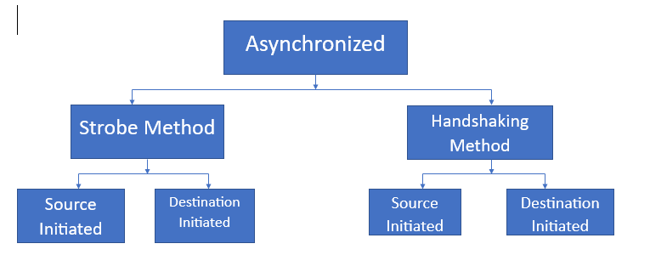
Classification of Asynchronous Data Transfer

Slide 6
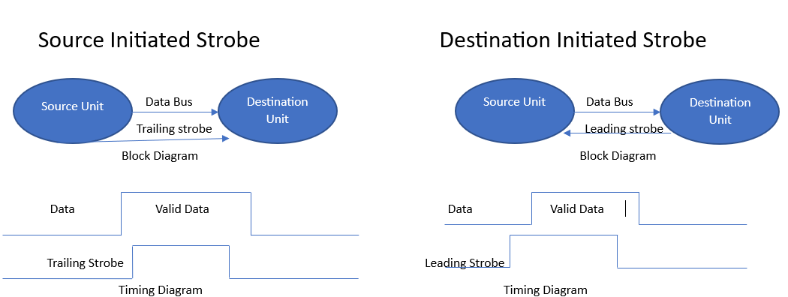
Source initiated strobe v/s Destination initiated Strobe
A specific signal or control line is used to synchronize the start and end of data transfers.
The strobe may be activated by either the source or the destination unit.

Slide 7
Source initiated strobe v/s Destination initiated Strobe
Source initiated strobe:
As shown in the timing diagram, the source unit first places the data on the data bus.
After a brief delay to ensure that the data settle to a steady value, the source activates the strobe pulse.
The information on the data bus and the strobe signal remain in the active state for a sufficient time period to allow the destination unit to receive the data.
Often, the destination unit uses the falling edge of the strobe pulse to transfer the contents of the data bus into one of its internal registers.
The source removes the data from the bus a brief period after it disables its strobe pulse. Actually, the source does not have to change the information in the data bus.
The fact that the strobe signal is disabled indicates that the data bus does not contain valid data.
New valid data will be available only after the strobe is enabled again.

Slide 8
Source initiated strobe v/s Destination initiated Strobe
Destination initiated Strobe:-
As in last figure, data transfer is initiated by the destination unit.
In this case the destination unit activates the strobe pulse, informing the source to provide the data.
The source unit responds by placing the requested binary information on the data bus.
The data must be valid and remain in the bus long enough for the destination unit to accept it.
In this leading edge of the strobe pulse is used.
The destination, the CPU, initiates the read operation to inform the memory, which is the source, to place a selected word into the data bus.

Slide 9
Handshaking
Handshaking: Data transfer between an interface and an I/O device is commonly controlled by a set of handshaking lines.
The basic principle of the two-wire handshaking method of data transfer is as follows.
One control line is in the same direction as the data flow in the bus from the source to the destination. It is used by the source unit to inform the destination unit whether there are valid data in the bus.
The other control line is in the other direction from the destination to the source. It is used by the destination unit to inform the source whether it can accept data.
In data transfer using handshaking lines, data transfer procedure can be of 2 types:-
Source initiated transfer using handshaking
Destination initiated transfer using handshaking

Slide 10
Source initiated transfer using handshaking
In Source initiated transfer using handshaking, the data transfer procedure is initiated by the source as shown in next figure.
The two handshaking lines are data valid and data accepted.
Data valid is generated by the source unit whereas data accepted is generated by the destination unit.
The timing diagram shows the exchange of signals between the two units.
The sequence of events are listed in part (c) of the next figure shows the four possible states that the system can be at any given time.
The source unit initiates the transfer by placing the data on the bus and enabling its data valid signal.
The data accepted signal is activated by the destination unit after it accepts the data from the bus.
The source unit then disables its data valid signal, which invalidates the data on the bus.
The destination unit then disables its data accepted signal and the system goes into its initial state.
The source does not send the next data item until after the destination unit shows its readiness to accept new data by disabling its data accepted signal.

Slide 11
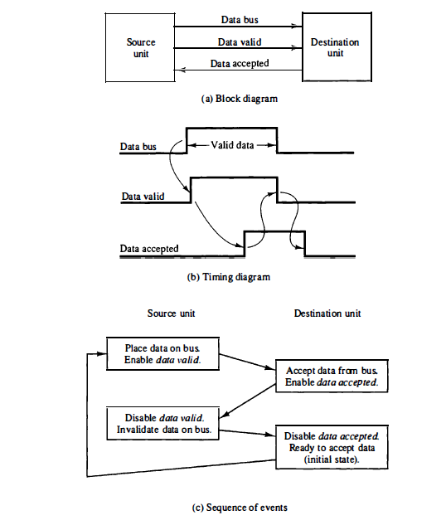
Source initiated transfer using handshaking

Slide 12
Destination initiated transfer using handshaking
Source initiated transfer using handshaking allows arbitrary delays from one state to the next and permits each unit to respond at its own data transfer rate. The rate of transfer is determined by the slowest unit.
To overcome the above problem, destination-initiated transfer using handshaking lines are used is shown in next figure.
Name of the signal generated by the destination unit has been changed to ready for data to reflect its new meaning.
The source unit in this case does not place data on the bus until after it receives the ready for data signal from the destination unit.
From there on, the handshaking procedure follows the same pattern as in the source-initiated case. Note that the sequence of events in both cases would be identical if we consider the ready for data signal as the complement of data accepted.
Only difference between the source-initiated and the destination-initiated transfer is in their choice of initial state.

Slide 13
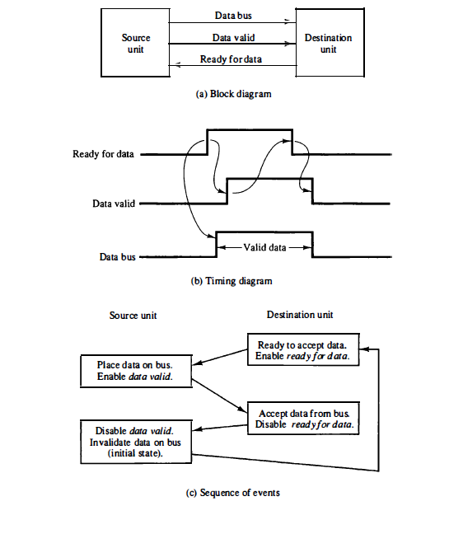
Destination initiated transfer using handshaking

Slide 14
Difference between Strobe-Initiated and handshaking data transfer
Aspect | Strobe-Initiated Data Transfer | Handshaking Data Transfer
Initiation Mechanism | Data transfer is initiated by a strobe signal. | Data transfer is initiated by a handshake protocol.
Timing | Timing critical; data is transferred on strobe edge. | Timing less critical; data is transferred after handshake confirmation.
Synchronization | Requires synchronization between sender and receiver using a common strobe signal. | Involves a synchronization process through exchange of control signals.
Complexity | Generally simpler as it involves a single signal for transfer initiation. | Can be more complex due to the need for multiple signals for handshaking.
Protocol Overhead | Lower protocol overhead as it involves fewer signals. | Higher protocol overhead due to the exchange of multiple control signals.
Error Handling | Limited error detection and handling capability. | Better error detection and handling through handshake protocols.
Application | Commonly used in simpler data transfer scenarios. | Suitable for more complex data transfer scenarios requiring reliability.

Slide 15
Asynchronous Serial Transfer
The transfer of data between two units may be done in parallel or serial.
In parallel data transmission, each bit of the message has its own path and the total message is transmitted at the same time. This means that an n-bit message must be transmitted through n separate conductor paths.
In serial data transmission, each bit in the message is sent in sequence one at a time. This method requires the use of one pair of conductors or one conductor and a common ground.
Parallel transmission is faster but requires many wires. It is used for short distances and where speed is important.
Serial transmission is slower but is less expensive since it requires only one pair of conductors.
Serial transmission can be synchronous or asynchronous. In synchronous transmission, the two units share a common clock frequency and bits are transmitted continuously at the rate dictated by the clock pulses. In long distant serial transmission, each unit is driven by a separate clock of the same frequency.
In asynchronous transmission, binary information is sent only when it is available and the line remains idle when there is no information to be transmitted. This is in contrast to synchronous transmission, where bits must be transmitted continuously.

Slide 16
Asynchronous Serial Transfer
A serial asynchronous data transmission technique used in many interactive terminals employs special bits that are inserted at both ends of the character code. With this technique, each character consists of three parts:
Start bit (The first bit, called the start bit, is always a 0 and is used to indicate the beginning of a character)
Character bits, and
Stop bit (The last bit called the stop bit is always a 1)
The convention is that the transmitter rests at the 1-state when no characters are transmitted.
An example of this format is shown below:-
1
1
0
0
0
1
0
1
Start
Character bits
Stop
bits

Slide 17
Example:-Asynchronous Serial Transfer
Consider the serial transmission of a terminal whose transfer rate is 10 characters per second. Each transmitted character consist of a start bit, eight information bits, and two stop bits, for a total of 11 bits. Ten characters per second means that each character takes 0.1 s for transfer. Since there are 11 bits to be transmitted, it follows that the bit time is 9.09 ms (0.1s/11 bits). The baud rate is defined as the rate at which serial information is transmitted and is equivalent to the data transfer in bits per second.
Determine the baud rate of serial transmission for transfer of 10 characters per second with an 11-bit format.
110 baud.

Slide 18
Universal Asynchronous Receiver Transmitter (UART)
The block diagram of an asynchronous communication interface is shown in next slide. It functions as both a transmitter and a receiver.
The interface is initialized for a particular mode of transfer by means of a control byte that is loaded into its control register. it defines certain parameters such as the baud rate to use, how many bits are in each character, whether to generate and check parity, and how many stop bits are appended to each character.
The transmitter register accepts a data byte from the CPU through the data bus. This byte is transferred to a shift register for serial transmission.
The receiver portion receives serial information into another shift register, and when a complete data byte is accumulated, it is transferred to the receiver register.
The CPU can select the receiver register to read the byte through the data bus.
The bits in the status register are used for input and output flags and for recording certain errors that may occur during the transmission. The CPU can read the status register to check the status of the flag bits and to determine if any errors have occurred.
The chip select and the read and write control lines communicate with the CPU.
The chip select (CS) input is used to select the interface through the address bus.
The register select (RS) is associated with the read (RD) and write (WR) controls. Two registers are write-only and two are read-only.

Slide 19
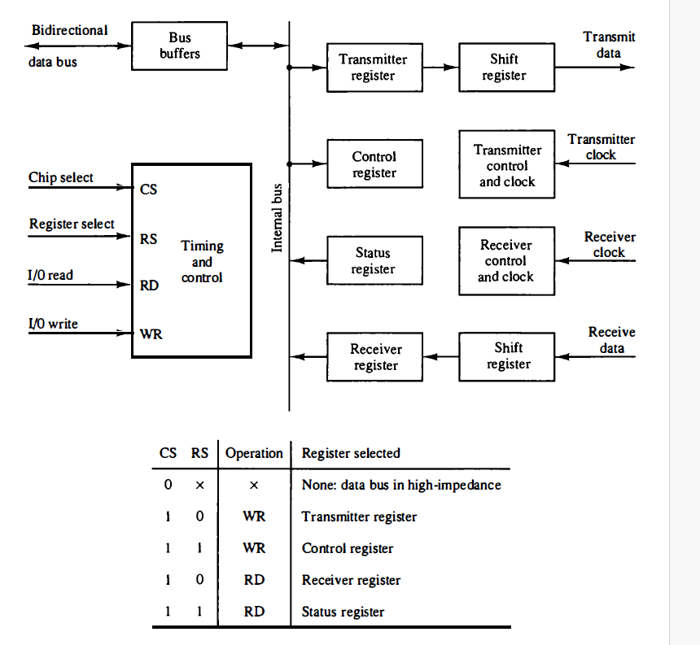
Universal Asynchronous Receiver Transmitter (UART)
Block diagram of a typical asynchronous communication interface

Slide 20
Operation of the transmitter portion - UART
The operation of the transmitter portion of the interface:-
Two bits in the status register are used as flags. The first bit used to indicate whether the transmitter register is empty and another bit is used to indicate whether the receiver register is full.
The CPU reads the status register and checks the flag to see if the transmitter register is empty . If it is empty, the CPU transfers a character to the transmitter register and the interface clears the flag to mark the register full.
The first bit in the transmitter shift register is set to 0 to generate a start bit.
The character is transferred in parallel from the transmitter register to the shift register and the appropriate number of stop bits are appended into the shift register.
The transmitter register is then marked empty.
The character can now be transmitted one bit at a time by shifting the data in the shift register at the specified baud rate.
The CPU can transfer another character to the transmitter register after checking the flag in the status register.
Such interface is said to be double buffered because a new character can be loaded as soon as the previous one starts transmission.

Slide 21
Operation of the receiver portion - UART
The operation of the receiver portion of the interface:-
The operation of the receiver portion of the interface is similar.
The receive data input is in the 1-state when the line is idle.
The receiver control monitors the receive-data line for a 0 signal to detect the occurrence of a start bit. Once a start bit has been detected, the incoming bits of the character are shifted into the shift register at the prescribed baud rate.
After receiving the data bits, the interface checks for the parity and stop bits. The character without the start and stop bits is then transferred in parallel from the shift register to the receiver register.
The flag in the status register is set to indicate that the receiver register is full.
The CPU reads the status register and checks the flag, and if set, it reads the data from the receiver register.

Slide 22
Errors during transmission - UART
The interface checks for any possible errors during transmission and sets
appropriate bits in the status register. The CPU can read the status register at
any time to check if any errors have occurred.
Three possible errors that the interface checks during transmission are:-
Parity error occurs if the number of l's in the received data is not the correct parity.
Framing error occurs if the right number of stop bits is not detected at the end of the received character.
An overrun error occurs if the CPU does not read the character from the receiver register before the next one becomes available in the shift register. Overrun error results in a loss of characters in the received data stream.

Slide 23
First-In-First-Out (FIFO) Buffer
A First-In-First-Out (FIFO) buffer is a data storage structure that operates on the principle of first-come, first-served.
It is a type of queue where data items are stored and retrieved in the order they were added.
FIFO buffers are used to temporarily store incoming and outgoing data packets. This helps in managing data flow between different devices and ensures that data is processed in the correct order.
When placed between two units, the FIFO can accept data from the source unit at one rate of transfer and deliver the data to the destination unit at another rate.
If the source unit is slower than the destination unit, the buffer can be filled with data at a slow rate and later emptied at the higher rate.
If the source is faster than the destination, the FIFO is useful for those cases where the source data arrive in bursts that fill out the buffer but the time between bursts is long enough for the destination unit to empty some or all the information from the buffer.
A FIFO buffer can be in one of two states: empty (no data in the buffer) or full (buffer is at maximum capacity).

Slide 24
Applications - First-In-First-Out (FIFO) Buffer
FIFO buffers are also used in communication systems such as UART (Universal Asynchronous Receiver-Transmitter), SPI (Serial Peripheral Interface), I2C (Inter-Integrated Circuit), and Ethernet etc.
FIFO buffers are extensively used in networking equipment such as routers, switches, and network interface cards (NICs) to handle incoming and outgoing network traffic.
FIFO buffer can be useful in some applications when data are transferred asynchronously.
In multimedia applications such as audio and video processing, FIFO buffers are used to store and manage multimedia data streams.
FIFO buffers are used in printers and scanners to temporarily store print jobs or scanned images before they are processed.
In real-time systems where timing and order of data processing are critical.
FIFO buffers find extensive use in various embedded systems, communication systems, data processing applications, and real-time systems where orderly data storage and retrieval are essential for proper system functionality.

